Slide 1
Scaling Kubernetes to Support 50,000 Services
Haibin Michael Xie, Senior Staff Engineer/Architect, Huawei
Quinton Hoole, Technical Vice President, Huawei

Slide 2
Agenda
Challenges while scaling services
Solutions and prototypes
Performance data
Q&A

Slide 3
What are the Challenges while Scaling Services
Control plane (Master, kubelet, kube-proxy)
Master
Controller Manager
API Server
Deploy services and pods
Propagate endpoints
Scheduler
ETCD
Data plane (load balancer)
Add/remove services in load balancer
Network access to services
…
Node
Node
KubeProxy
Kubelet
KubeProxy
Kubelet
Load Balancer
Load Balancer
Pod
Pod
Pod
Pod
Pod
Pod

Slide 4
Control Plane
API Server
ETCD
Service deployed
Controller Manager
services
Pod deployed and scheduled
Endpoints
Controller
pods
N nodes per cluster
M pods per second
endpoints
QPS: N*M endpoints per second
… …
Node
Node
Node
KubeProxy
KubeProxy
KubeProxy

Slide 5
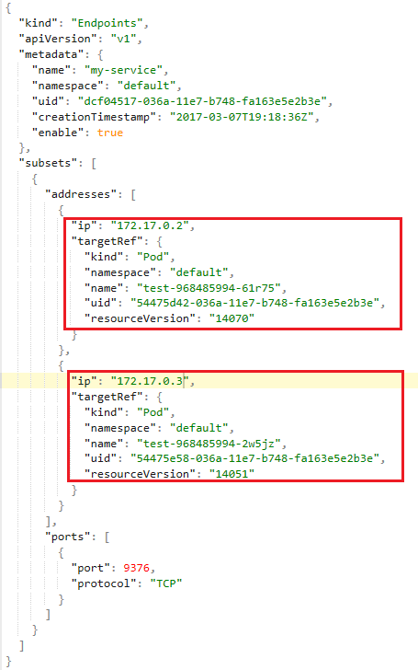
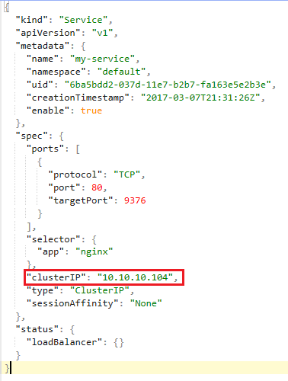
Endpoints
/registry/services/endpoints/default/my-service
/registry/services/specs/default/my-service

Slide 6
Control Plane
API Server
ETCD
Controller Manager
services
Endpoints
Controller
pods
N nodes per cluster
M pods per second
endpoints
QPS: N*M endpoints per second
Load: N*M*(M+1)/2 addresses per second
… …
Node
Node
Node
KubeProxy
KubeProxy
KubeProxy

Slide 7
Control Plane Solution Alternatives
Partition endpoints object into multiple objects
Pros: reduce Endpoints object size
Cons: increase # of objects and requests
Central load balancer
Pros: reduce connections and requests to API server
Cons: one more hop in service routing, require strong HA, limited LB scalability
Batch creating/updating endpoints
Timer based, no change to data structure in ETCD
Pros: reduce QPS
Cons: E2E latency is increased by Batch interval

Slide 8
Control Plane Solution
API Server
ETCD
Controller Manager
services
Endpoints
Controller
pods
N nodes per cluster
M pods per second
Timer and batch
endpoints
QPS: N*M per second
Load: N*M*(M+1)/2 addresses per second
QPS: N*M per second
Load: N*M*(M+1)/2 addresses per second
QPS: N per second
Load: N*M addresses per second
… …
Node
Node
Node
KubeProxy
KubeProxy
KubeProxy

Slide 9
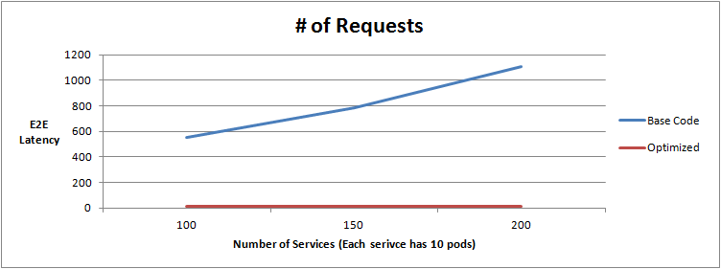
Batch Processing Request Reduction
Test setup:
1 Master，4 slaves
16 core 2.60GHz, 48GB RAM
Pods per Service | Number of Service | EndPoints Controller # of Requests
 |  | Before | After | Reduction
10 | 100 | 551 | 10 | 98.2%
 | 150 | 785 | 14 | 98.2%
 | 200 | 1105 | 17 | 98.5%
One batch per 0.5 second.
QPS：reduced 98%

Slide 10
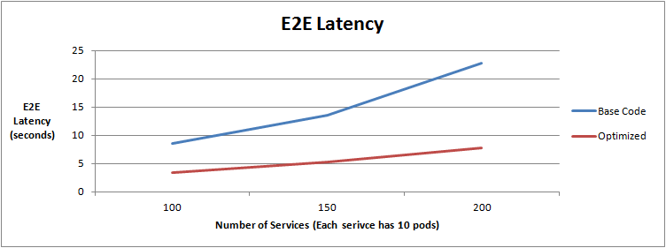
Batch Processing E2E Latency Reduction
Latency： reduced 60+%
Pods per Service | Number of Service | E2E Latency (Second)
 |  | Before | After | Reduction
10 | 100 | 8.5 | 3.5 | 59.1%
 | 150 | 13.5 | 5.3 | 60.9%
 | 200 | 22.8 | 7.8 | 65.8%

Slide 11
Data Plane
What is IPTables?
iptables is a user-space application that allows configuring Linux kernel firewall (implemented on top of Netfilter) by configuring chains and rules.
What is Netfilter? A framework provided by the Linux kernel that allows customization of networking-related operations, such as packet filtering, NAT, port translation etc.
Issues with IPTables as a load balancer
Latency to access service (routing latency)
Latency to add/remove rules

Slide 12
IPTables Example
# Iptables –t nat –L –n
Chain PREROUTING (policy ACCEPT)
target prot opt source destination
KUBE-SERVICES all -- anywhere anywhere /* kubernetes service portals */ ← 1
DOCKER all -- anywhere anywhere ADDRTYPE match dst-type LOCAL
Chain KUBE-SEP-G3MLSGWVLUPEIMXS (1 references) ← 4
target prot opt source destination
MARK all -- 172.16.16.2 anywhere /* default/webpod-service: */ MARK set 0x4d415351
DNAT tcp -- anywhere anywhere /* default/webpod-service: */ tcp to:172.16.16.2:80
Chain KUBE-SEP-OUBP2X5UG3G4CYYB (1 references)
target prot opt source destination
MARK all -- 192.168.190.128 anywhere /* default/kubernetes: */ MARK set 0x4d415351
DNAT tcp -- anywhere anywhere /* default/kubernetes: */ tcp to:192.168.190.128:6443
Chain KUBE-SEP-PXEMGP3B44XONJEO (1 references) ← 4
target prot opt source destination
MARK all -- 172.16.91.2 anywhere /* default/webpod-service: */ MARK set 0x4d415351
DNAT tcp -- anywhere anywhere /* default/webpod-service: */ tcp to:172.16.91.2:80
Chain KUBE-SERVICES (2 references) ← 2
target prot opt source destination
KUBE-SVC-N4RX4VPNP4ATLCGG tcp -- anywhere 192.168.3.237 /* default/webpod-service: cluster IP */ tcp dpt:http
KUBE-SVC-6N4SJQIF3IX3FORG tcp -- anywhere 192.168.3.1 /* default/kubernetes: cluster IP */ tcp dpt:https
KUBE-NODEPORTS all -- anywhere anywhere /* kubernetes service nodeports; NOTE: this must be the last rule in this chain */ ADDRTYPE match dst-type LOCAL
Chain KUBE-SVC-6N4SJQIF3IX3FORG (1 references)
target prot opt source destination
KUBE-SEP-OUBP2X5UG3G4CYYB all -- anywhere anywhere /* default/kubernetes: */
Chain KUBE-SVC-N4RX4VPNP4ATLCGG (1 references) ← 3
target prot opt source destination
KUBE-SEP-G3MLSGWVLUPEIMXS all -- anywhere anywhere /* default/webpod-service: */ statistic mode random probability 0.50000000000
KUBE-SEP-PXEMGP3B44XONJEO all -- anywhere anywhere /* default/webpod-service: */

Slide 13
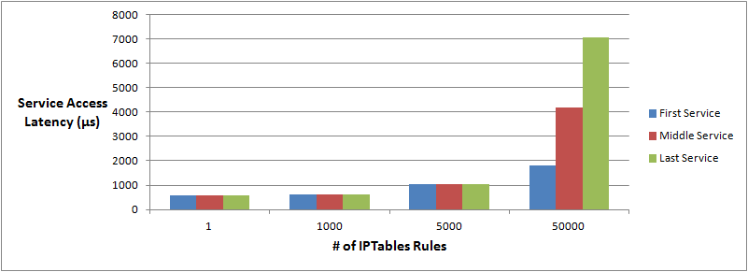
IPTables Service Routing Performance
Where is latency generated?
Long list of rules in a chain
Enumerate through the list to find a service and pod
In this test, there is one entry per service in KUBE-SERVICES chain.
 | 1 Service (µs) | 1000 Services (µs) | 10000 Services (µs) | 50000 Services (µs)
First Service | 575 | 614 | 1023 | 1821
Middle Service | 575 | 602 | 1048 | 4174
Last Service | 575 | 631 | 1050 | 7077

Slide 14
Latency to Add IPTables Rules
Where is the latency generated?
not incremental
copy all rules
make changes
save all rules back
IPTables locked during rule update
Time spent to add one rule when there are 5k services (40k rules): 11 minutes
20k services (160k rules): 5 hours

Slide 15
Data Plane Solution
Re-structure IPTables using a search tree
Performance improvement
Replace IPTables with “IP Virtual Server” (IPVS)
Dramatic performance
Much smarter load balancing
weighted
retries
… etc

Slide 16
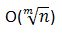
Restructure IPTables as a Search Tree
Service VIP range: 10.10.0.0/16
CIDR list = [16, 24], defines tree layout
Create 3 services: 10.10.1.5, 10.10.1.100, 10.10.100.1
10.10.0.0/16
10.10.1.0/24
10.10.100.0/24
VIP
VIP: 10.10.1.5
VIP:10.10.1.100
VIP:10.10.100.1
Search tree based service routing time complexity: , m is tree depth
Original service routing time complexity: O(n)

Slide 17
What is IP Virtual Server (IPVS)?
Transport layer load balancer which directs requests for TCP and UDP based services to real servers.
Part of the Linux Virtual Server (LVS) project.
As with IPTables, IPVS is built on top of Netfilter.
Supports 3 load balancing modes:
NAT
DR (L2 load balancing via MAC rewriting)
IP Tunneling

Slide 18
IPVS vs. IPTables
IPTables:
Manipulates tables provided by the linux firewall
IPTables is more flexible and can manipulate packets at different stages: Pre-routing, post-routing, forward, input, output.
IPTables has more operations: SNAT, DNAT, reject packets, port translation etc.
Why use IPVS?
Better performance (Hashing vs. Chains)
More load balancing algorithms
Round robin, source/destination hashing.
Based on least load, least connection or locality, can assign weights to servers.
Supports server health checks and connection retries
Supports sticky sessions

Slide 19
IPVS Load Balancing Mode in Kubernetes
Not publically released yet
No Kubernetes behavior changes, fully compatible:
external IP, nodePort etc
Added kube-proxy startup parameter mode=IPVS, in addition to original modes: mode=userspace and mode=iptables
Original kube-proxy lines of code: 11800
IPVS mode adds 680 lines of code
dependent on seasaw library

Slide 20
IPVS vs. IPTables Latency to Add Rules
Measured by iptables and ipvsadm, observations:
In IPTables mode, latency to add rule increases significantly when # of service increases
In IPVS mode, latency to add VIP and backend IPs does not increase when # of service increases
# of Services | 1 | 5,000 | 20,000
# of Rules | 8 | 40,000 | 160,000
IPTables | 2 ms | 11 min | 5 hours
IPVS | 2 ms | 2 ms | 2 ms

Slide 21
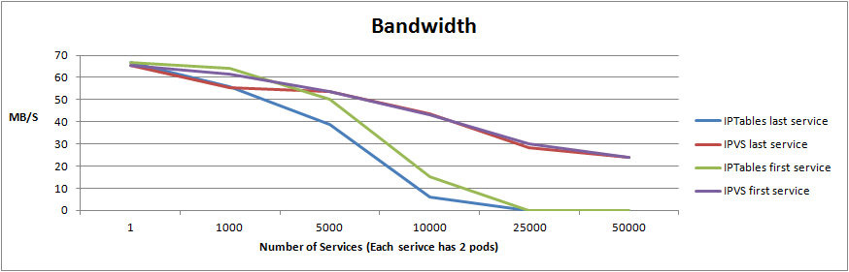
IPVS vs. IPTables Network Bandwidth
Measured by qperf
Bandwidth, QPS, Latency have similar pattern
Env: 1 master, 4 slaves, 8 pods, all services use these 8 pods
Each service exposes 4 ports (4 entries in KUBE-SERVICES chain)
ith service | first | first | last | first | last | first | last | first | last | first | last
# of services | 1 | 1000 | 1000 | 5000 | 5000 | 10000 | 10000 | 25000 | 25000 | 50000 | 50000
Bandwidth, IPTables (MB/S) | 66.6 | 64 | 56 | 50 | 38.6 | 15 | 6 | 0 | 0 | 0 | 0
Bandwidth, IPVS (MB/S) | 65.3 | 61.7 | 55.3 | 53.5 | 53.8 | 43 | 43.5 | 30 | 28.5 | 24 | 23.8

Slide 22
Other Perf/Scalability Work We Have Done...
Scale nodes and pods in single cluster
Reduce E2E latency of deploying pods/services
Increase pod deployment throughput
Improve scheduling performance
Optimistic concurrent scheduler
Flow graph based high performance scheduling and rescheduling with the University of Cambridge (UK).

Slide 23
Thank You
quinton.hoole@huawei.com
haibin.michael.xie@huawei.com

